Slide 1
Project title
CAPSTONE PROJECT
Presented By:
Student Name- SIDDHARTH SANDESH MAHAJAN
College Name- SAVITRIBAI PHULE PUNE UNIVERSITY
Department- DEPARTMENT OF TECHNOLOGY

Slide 2
OUTLINE
Problem Statement (Should not include solution)
Proposed System/Solution
System Development Approach (Technology Used)
Algorithm & Deployment
Result
Conclusion
Future Scope
References

Slide 3
Problem Statement
Healthcare systems often face challenges in efficiently managing healthcare resources such as hospital beds, doctors, staff, and ambulances. The lack of centralized monitoring and predictive planning can lead to resource shortages, delays in patient transfers, inefficient utilization of healthcare infrastructure, and slower decision-making. Additionally, healthcare administrators often rely on manual reporting processes, making it difficult to obtain real-time insights for operational planning.

Slide 4
Proposed Solution
Data Collection Synthetic healthcare datasets were generated for educational purposes, including patient records, facility information, doctor data, staff details, ambulance records, transfer information, pharmacy data, municipality summaries, and resource utilization records.
Data Preprocessing The datasets were cleaned, validated, and organized using Python, Pandas, and NumPy. Relevant healthcare parameters were selected for analysis and prediction.
Database Integration Processed data was stored in a centralized SQLite database to enable efficient data retrieval and management.
System Development A web-based healthcare coordination platform was developed using Streamlit. Multiple modules were created for dashboard analytics, patient management, facility monitoring, transfer tracking, ambulance monitoring, and municipality reporting.
Artificial Intelligence Integration Google Gemini 2.5 Flash was integrated to provide healthcare assistance, intelligent recommendations, and automated municipality report generation.
Machine Learning Implementation A Random Forest Regressor model was trained using healthcare resource utilization data. Features such as patient admissions, discharges, available beds, doctors, staff, and ambulances were used to predict future bed occupancy levels.
Result Generation The platform generates real-time analytics, AI-powered insights, municipality reports, and predictive bed occupancy forecasts to support healthcare resource planning and decision-making.

Slide 5
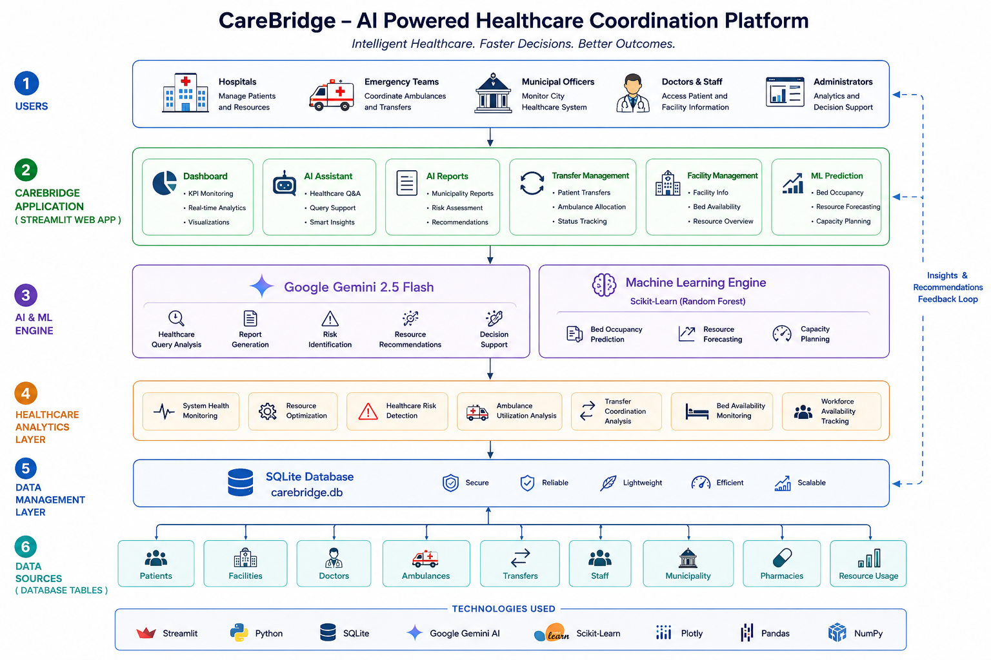
System Approach
Frontend:
• Streamlit
Backend:
• Python
Database:
• SQLite
Artificial Intelligence:
• Google Gemini 2.5 Flash
Machine Learning:
• Random Forest Regressor
Data Processing:
• Pandas, NumPy
Data Visualization:
• Plotly
Model Storage:
• Joblib
Version Control:
• GitHub
Deployment:
• Streamlit Cloud

Slide 6
Algorithm & Deployment
Machine Learning Algorithm:
Random Forest Regressor
Purpose:
Predict future bed occupancy based on healthcare resource data.
Input Parameters:
• Patients In
• Patients Out
• Beds Available
• Doctors Available
• Staff Available
• Ambulances Available
Output:
• Predicted Bed Occupancy
Deployment:
• Application deployed using Streamlit Cloud
• Source code hosted on GitHub
• Gemini API integrated through Streamlit Secrets
• ML model deployed using Joblib (.pkl file)
Random Forest was selected due to its robustness, ability to handle complex feature relationships, and resistance to overfitting.

Slide 7
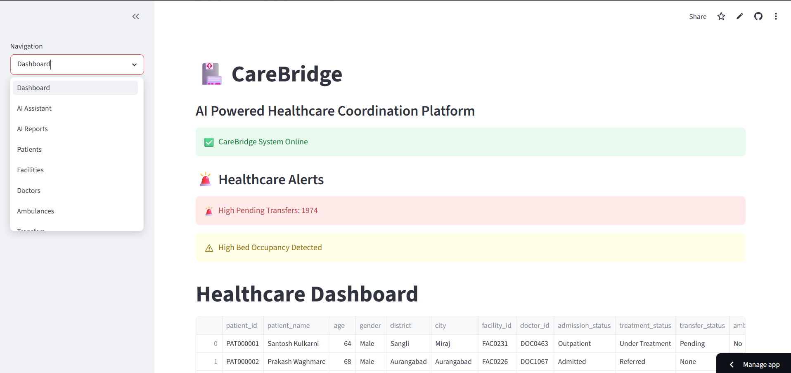
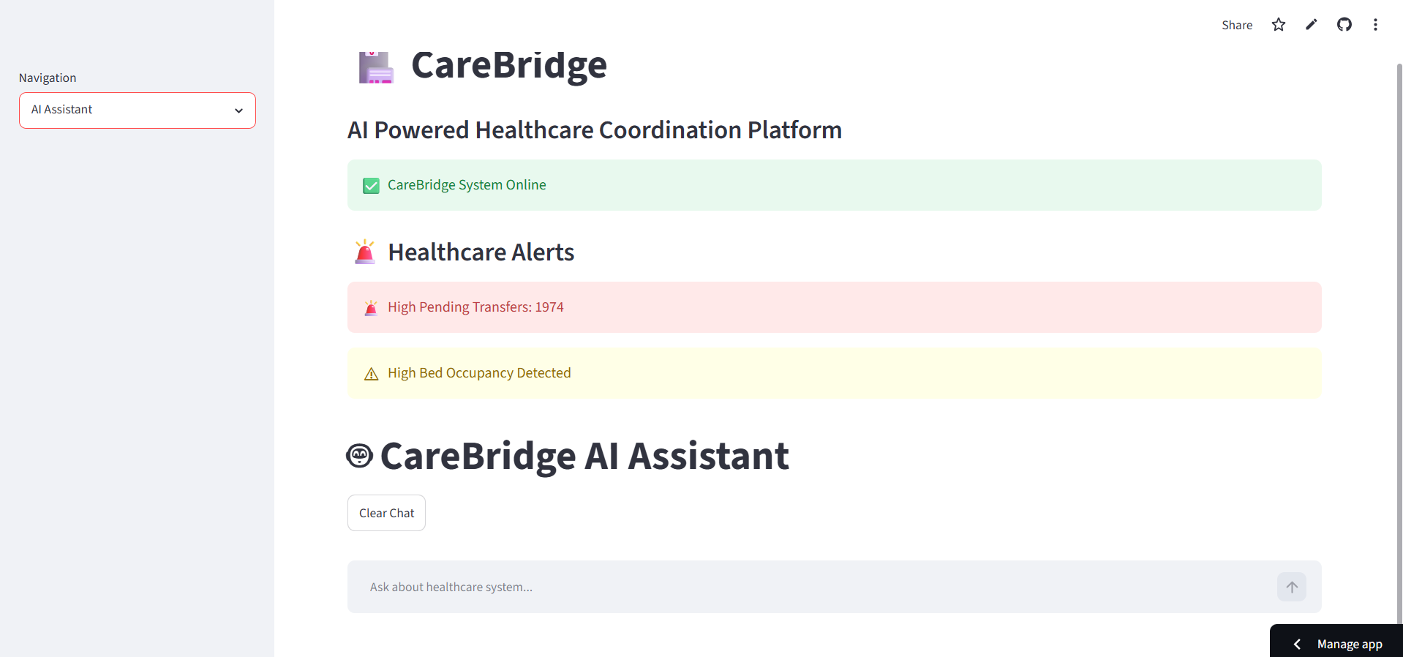
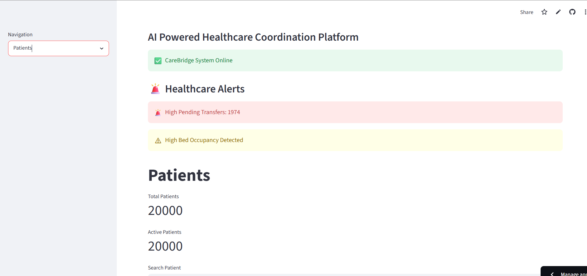
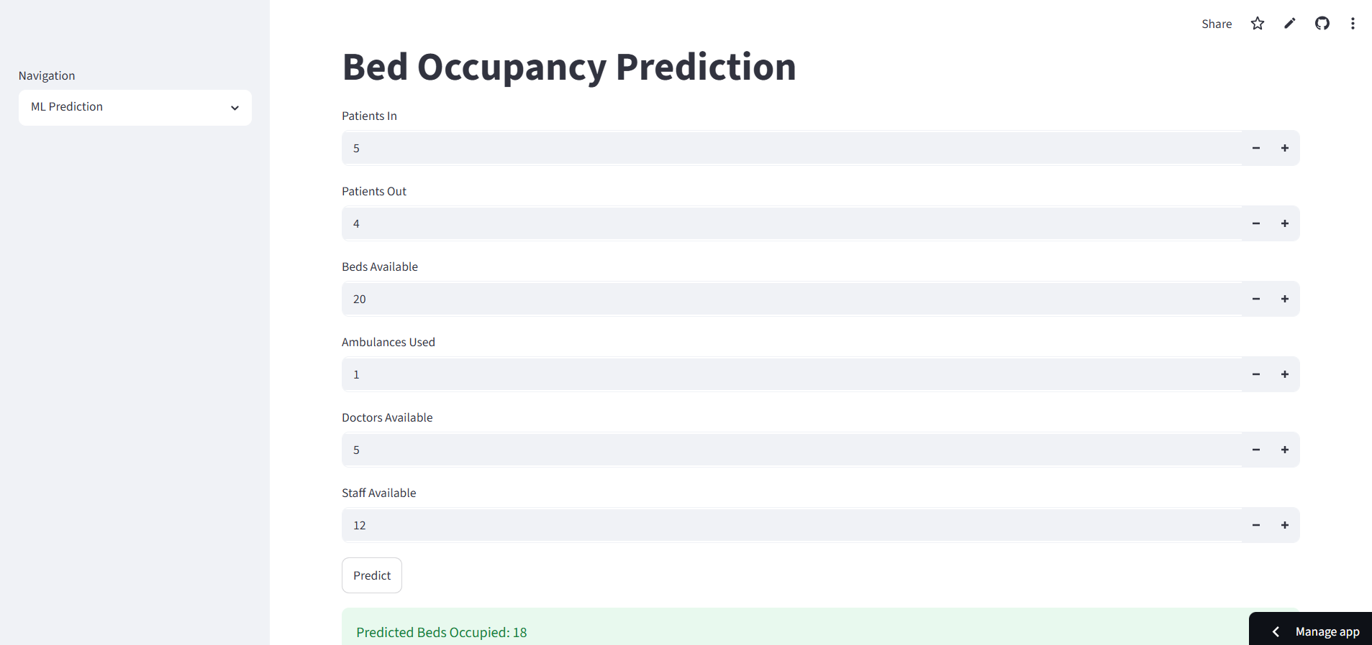
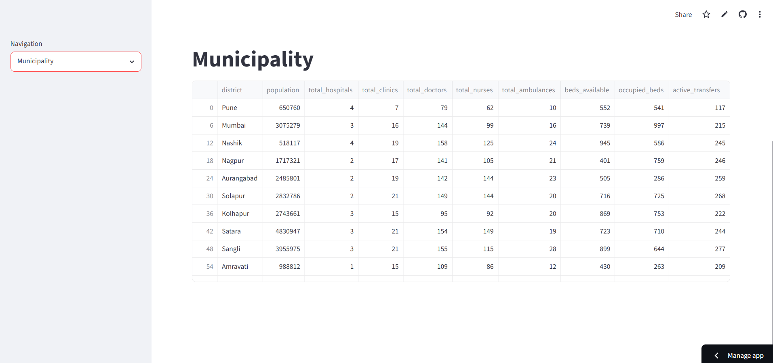
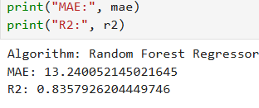
Result
Model Evaluation Results

Slide 8
Conclusion
• CareBridge successfully integrates Artificial Intelligence, Machine Learning, and healthcare analytics into a unified healthcare coordination platform.
• The system provides real-time resource monitoring, AI-powered assistance, automated municipality reporting, and predictive bed occupancy forecasting to support healthcare decision-making.
• The Random Forest Regressor achieved strong predictive performance with an R² Score of 83.6% and an MAE of 13.24, demonstrating its effectiveness in healthcare resource planning.
• By enabling data-driven decision-making, CareBridge can help healthcare administrators optimize resource utilization, improve operational efficiency, and enhance healthcare management processes.
• The project demonstrates the potential social impact of AI-driven healthcare solutions in supporting smarter, more efficient, and accessible healthcare systems.
• Overall, CareBridge establishes a scalable foundation for future intelligent healthcare management and digital health innovation.

Slide 9
Future scope
• Integration with real hospital information systems and healthcare databases.
• Development of a mobile application for healthcare administrators and medical staff.
• Real-time ambulance tracking and emergency response coordination.
• Integration with IoT devices and wearable health monitoring systems.
• Advanced AI-powered healthcare recommendations and decision support.
• Multi-language support for wider accessibility across different regions.
• Cloud-scale deployment for supporting multiple hospitals and municipalities.
• Enhanced predictive analytics for patient flow, resource demand, and healthcare capacity planning.
• Integration with government healthcare platforms for improved public health management.
• Expansion into a comprehensive smart healthcare ecosystem powered by AI and Machine Learning.

Slide 10
References
Google Generative AI (Gemini) Documentation https://ai.google.dev/
Streamlit Documentation https://docs.streamlit.io/
Scikit-Learn Documentation https://scikit-learn.org/stable/
Pandas Documentation https://pandas.pydata.org/docs/
NumPy Documentation https://numpy.org/doc/
Plotly Documentation https://plotly.com/python/
SQLite Documentation https://www.sqlite.org/docs.html
CareBridge Synthetic Healthcare Dataset (Kaggle) https://www.kaggle.com/datasets/siddharth564/carebridge-synthetic-healthcare-dataset
CareBridge GitHub Repository https://github.com/siddharthmahajan2477-dot/CareBridge

Slide 11
Github link
Github Link : https://github.com/siddharthmahajan2477-dot/CareBridge.git
Deployment Link: https://carebridge.streamlit.app/

Slide 12
THANK YOU

